Slide 1


Carers Innovation Fund
Sue Bernie - Carers of Barking and Dagenham
Arabjan Iqbal – London Borough of Barking and Dagenham

Slide 2
Carers in Barking and Dagenham
Provide a Valuable Contribution to the Health and Social Care ECoNOMY
ExpErts BY EXPERIENCE with EXTENSIve KNOWLEDGE
SUPPORT CarerS in Their Caring ROLE

Slide 3
Current carers support
Eligible carers receive support through a direct payment and access services to support them in their caring role.
Develop the carers market with a view to accessing these service through personal budgets.
Legacy aspect is important in the innovation fund.
Commissioned service – delivered by Carers of Barking and Dagenham, also managing the Carers Innovation Fund.

Slide 4

Carers Charter

Slide 5
Carers Innovation Fund
Carers innovation fund set up to develop the carers market
One specific fund looks at Psychological support
Providers invited to submit Proposals to engage Carers Locally
Notes:
Lot 2 for £11,000 open to any kind submission that delivers on the Carers Charter and engages carers locally.

Slide 6
Census 2021- Carers Data
Unpaid care (5 categories) | Percentage of population | Number
Provides 9 hours or less unpaid care a week | 1.8 | 3533
Provides 10 to 19 hours unpaid care a week | 1.0 | 1983
Provides 20 to 34 hours unpaid care a week | 0.9 | 1827
Provides 35 to 49 hours unpaid care a week | 1.1 | 2162
Provides 50 or more hours unpaid care a week | 2.3 | 4719
Total |  | 14,224

Slide 7
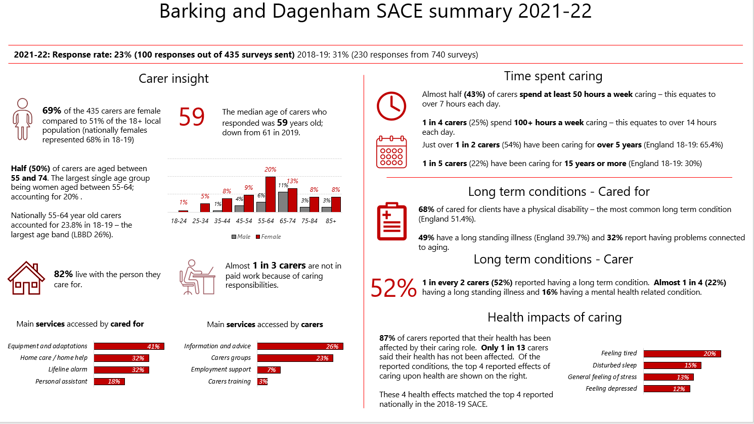
Notes:
A recent SACE survey has been carried out and the data is awaiting publication.

Slide 8
Additional Resources
Carers Charter update report –Issue - items at meetings - Carers Charter and Action Plan Update | LBBD
Carers Identification and Referral Training -https://www.eventbrite.com/cc/carers-identification-referral-pathway-training-2363729?utm-campaign=social&utm-content=attendeeshare&utm-medium=discovery&utm-term=odclsxcollection&utm-source=cp&aff=odclsxcollection
Health and Wellbeing Strategy LBBD JHWS 2023-28.pdf
Carers of Barking and Dagenham Welcome to Carers Centre SA Ltd | Carers of Barking and Dagenham
London Borough of Barking and Dagenham Carers Carers | London Borough of Barking and Dagenham (lbbd.gov.uk)
Commissioning Toolkit -Toolkit :: Home (artscommissioningtoolkit.com)

Slide 9
Timetable
Description | Date
Market Engagement Event | 12 January 2024
Launch Carers Innovation Fund | w/c 15 January 2024
Deadline for completed grant submissions | 19 February 2024
Presentation | 29 February 2024
Funding award notifications | w/c 11 March 2024
Project delivery | From April 2024

Slide 10





Questions

